Slide 1
Section 7.1
Angles and Their Measure
Copyright © 2012 Pearson Education, Inc. Publishing as Prentice Hall.

Slide 2

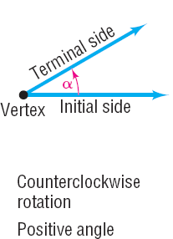
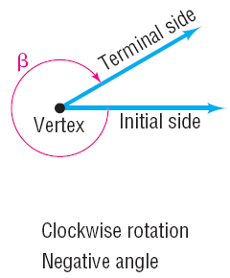
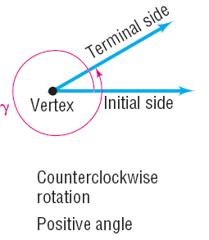
Copyright © 2012 Pearson Education, Inc. Publishing as Prentice Hall.

Slide 3
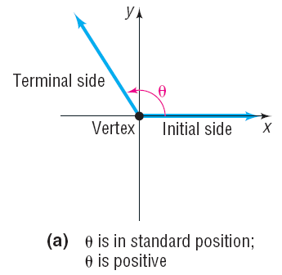
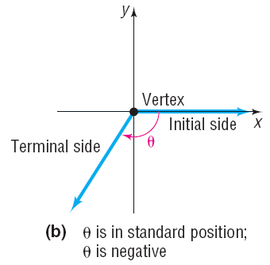
Copyright © 2012 Pearson Education, Inc. Publishing as Prentice Hall.

Slide 4
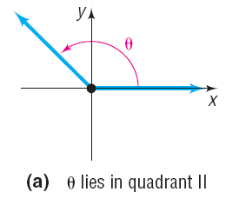
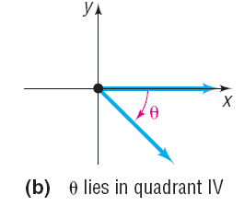
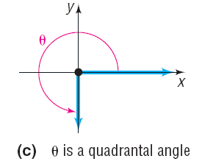
Copyright © 2012 Pearson Education, Inc. Publishing as Prentice Hall.

Slide 5
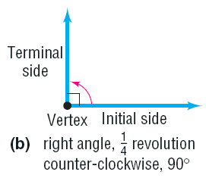
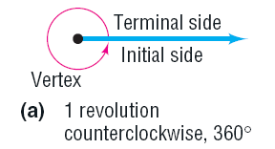
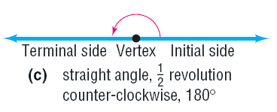
Copyright © 2012 Pearson Education, Inc. Publishing as Prentice Hall.

Slide 6



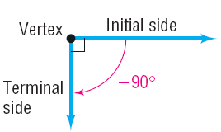
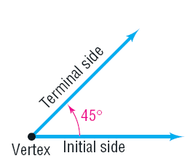
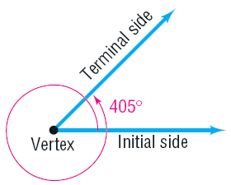
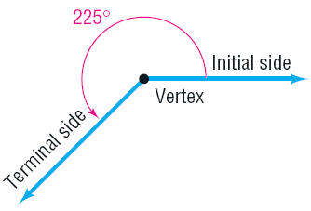
Copyright © 2012 Pearson Education, Inc. Publishing as Prentice Hall.

Slide 7
Copyright © 2012 Pearson Education, Inc. Publishing as Prentice Hall.

Slide 8

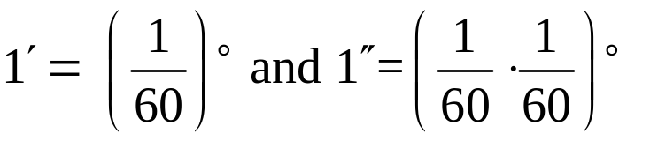
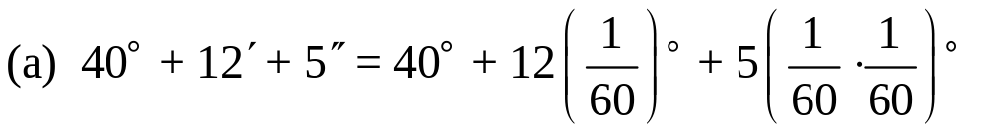








Convert 40°12’5” to a decimal in degrees. Round the answer to four decimal places.
Convert 78.562° to the D°M’S” form. Round the answer to the nearest second.
Copyright © 2012 Pearson Education, Inc. Publishing as Prentice Hall.

Slide 9
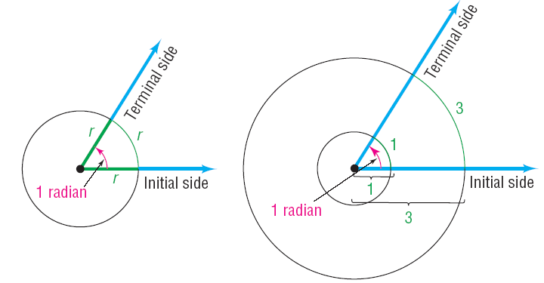
Radians
Copyright © 2012 Pearson Education, Inc. Publishing as Prentice Hall.

Slide 10
Copyright © 2012 Pearson Education, Inc. Publishing as Prentice Hall.

Slide 11
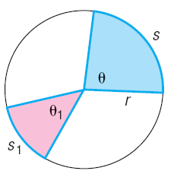

Copyright © 2012 Pearson Education, Inc. Publishing as Prentice Hall.

Slide 12

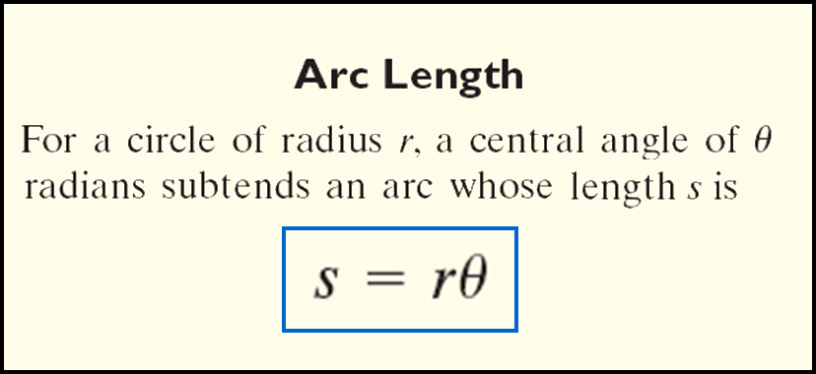
Copyright © 2012 Pearson Education, Inc. Publishing as Prentice Hall.

Slide 13

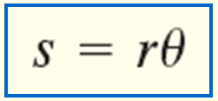
Find the length of the arc of a circle of radius 4 meters subtended by a central angle of 0.5 radian.
Copyright © 2012 Pearson Education, Inc. Publishing as Prentice Hall.

Slide 14
Copyright © 2012 Pearson Education, Inc. Publishing as Prentice Hall.

Slide 15
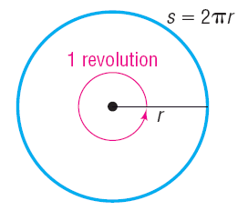



Copyright © 2012 Pearson Education, Inc. Publishing as Prentice Hall.

Slide 16

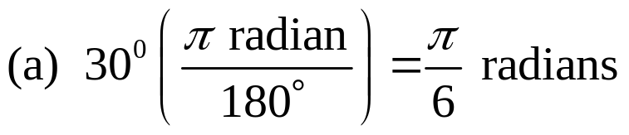




(a) 30° (b) 120° (c) – 60° (d) 270° (e) 104 °
Copyright © 2012 Pearson Education, Inc. Publishing as Prentice Hall.

Slide 17
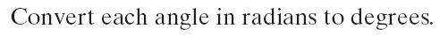
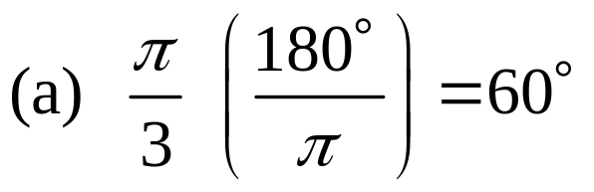
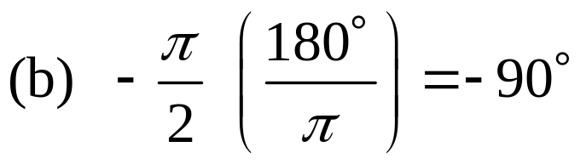
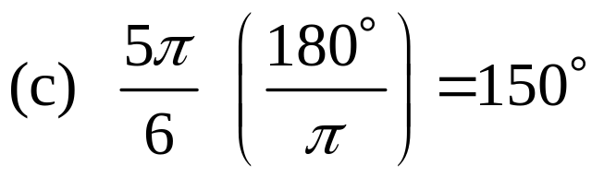
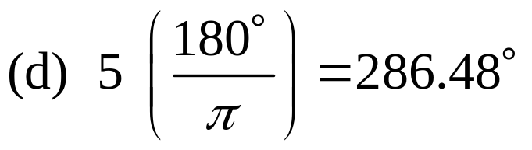
Copyright © 2012 Pearson Education, Inc. Publishing as Prentice Hall.

Slide 18
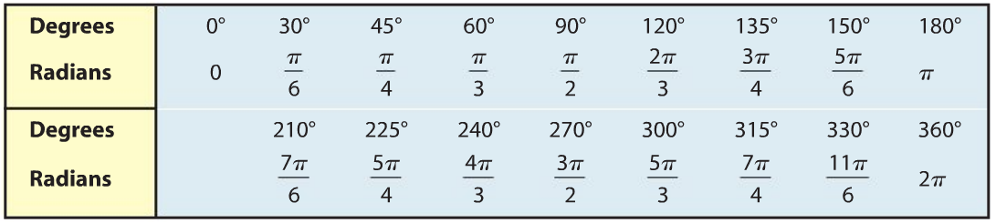
Copyright © 2012 Pearson Education, Inc. Publishing as Prentice Hall.

Slide 19
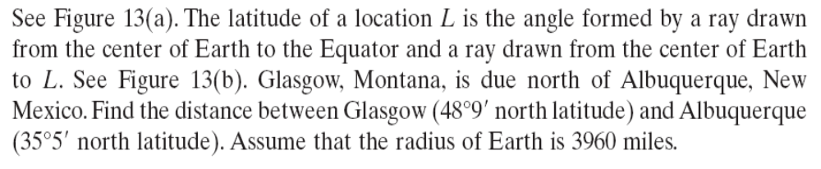
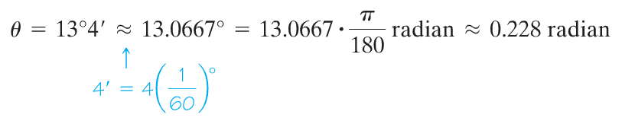
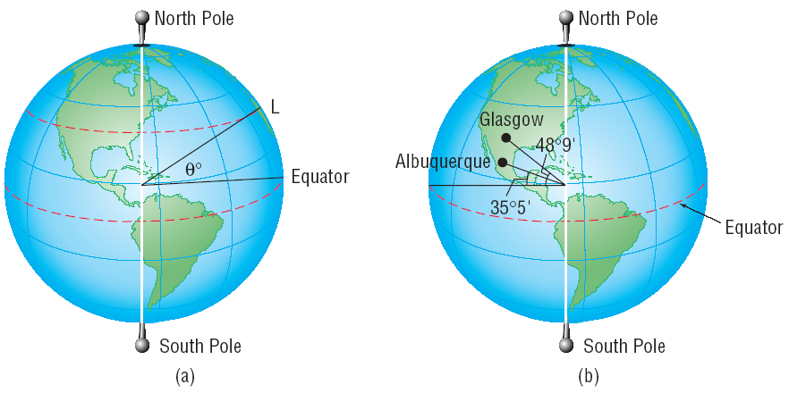

Figure 13 (a)
Figure 13 (b)

Slide 20
Copyright © 2012 Pearson Education, Inc. Publishing as Prentice Hall.

Slide 21

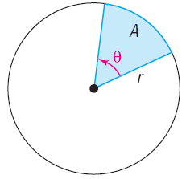
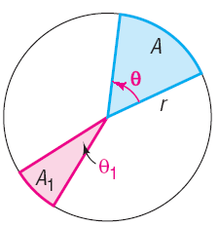

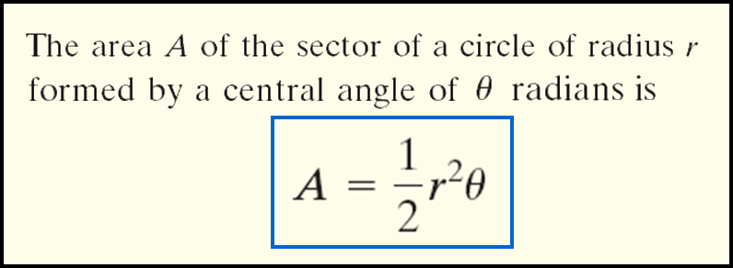
Copyright © 2012 Pearson Education, Inc. Publishing as Prentice Hall.

Slide 22
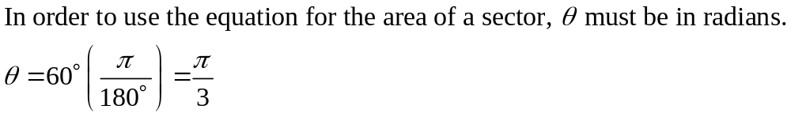
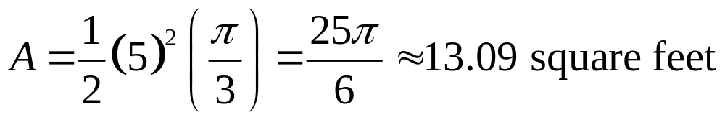
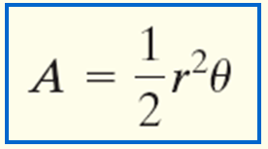
Find the area of the sector of a circle of radius 5 feet formed by an angle of 60°. Round the answer to two decimal places.
Copyright © 2012 Pearson Education, Inc. Publishing as Prentice Hall.

Slide 23
Copyright © 2012 Pearson Education, Inc. Publishing as Prentice Hall.

Slide 24

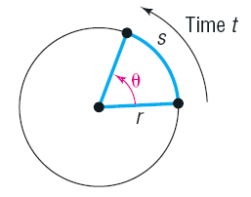


Linear Speed
Angular Speed
Copyright © 2012 Pearson Education, Inc. Publishing as Prentice Hall.

Slide 25


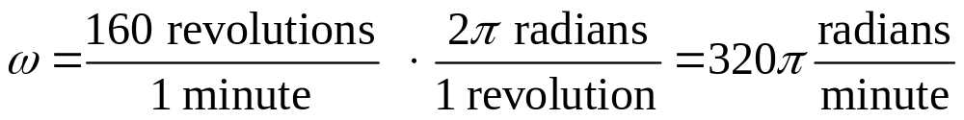
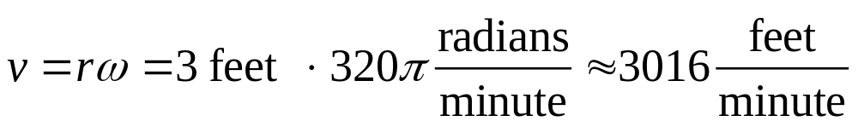
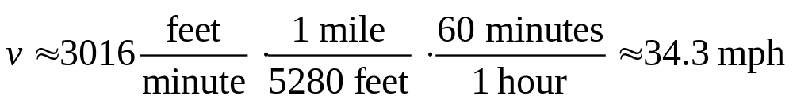
A child is spinning a rock at the end of a 3-foot rope at the rate of 160 revolutions per minute (rpm). Find the linear speed of the rock when it is released.
3
Copyright © 2012 Pearson Education, Inc. Publishing as Prentice Hall.

